Slide 1
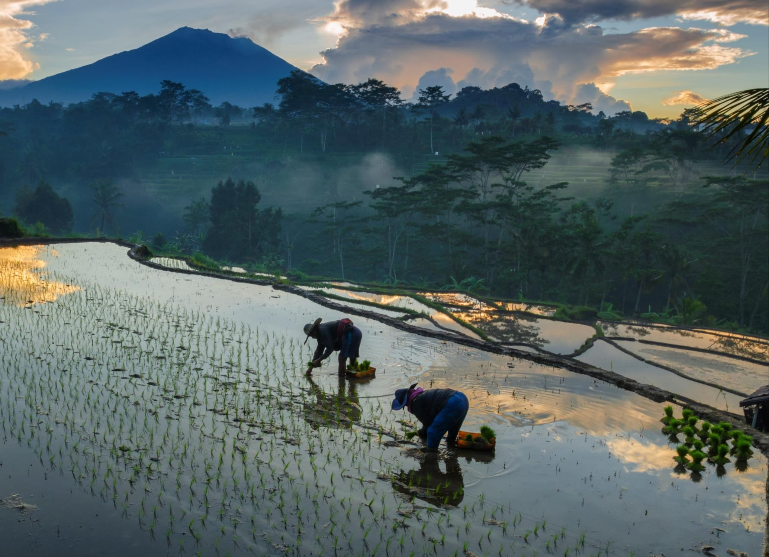


Global Microfinance Case Competition 2023
UFH:
Towards an Inclusive and Sustainable Financial Network
Team: The Big Four Bhavika Rajora Falak Kalra Ishan Anand Parth Khanna

Slide 2

Analysing the landscape Problems Solutions
Implementation and Impact Appendix

Slide 3
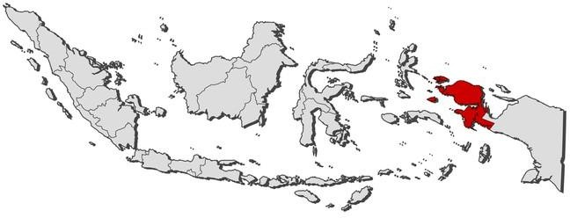







SOCIOECONOMIC ANALYSIS
Assessing Indonesia’s Macroeconomic Challenges To bridge gaps through proposed strategy
Poverty puts the heaviest pressure in...
Macroeconomic Indicators
The Way Ahead
YoY%
60
49% of the Adult Population hold an account in financial institutions
40
20
0
Households'
Non financial corporations
2011Q1 2020Q1
Papua, West Papua and West Nusa Tenggara have poverty rates above 20%
The COVID-19 recession further reduced credit growth, due to increase in risk associated
with borrowers’ risk profile
-20
2003Q1
Weakened Credit Growth to the Real Sectors
The literacy rate is lowest in Papua with approximately 20% of the population over 15 being illiterate
As of 2020
Economic insecurity coupled with after-effects of Covid-19 has degenerated financial inclusion in Indonesia and the only way out is a decentralised
Sustainable Credit Inclusion Grid (CREDILINK)
9.5% of the population lives below the National Poverty Line
75%
Financial
inclusion achieved
38%
Indonesians
are financially illiterate
yet
Sources: OCED library, ABF, OJK Surveys
Overview
Phoenix: Short Term
Phoenix: Long Term
Impact and Implementation
Appendix
1.

Slide 4













EXPLORING THE MICROFINANCE LANDSCAPE IN INDONESIA
Analyzing Indonesia’s financial profile and addressing key challenges through proposed strategy
Indonesia is renowned for its large-scale microfinance sector, with a range of commercial banks and over 60,000 MFIs reaching more than 50 million people
Integral Challenges
Adverse Repayment Abilities of Micro Borrowers
174 trillion IDR
Funds distributed by Rural Banks
50 mn + MSMEs
Contribute more than 30% of GDP growth
Increased Cost of Borrowing
Arduous Loan Application
Understanding the Financial and Technological Environment
Unspecialised Product Offerings
Mandate by Bank Indonesia
Banks to have at least 20% of their loan portfolio in micro loans
What can be done?
Delay in Loan Repayments
Increase in NPLs from 3.35% to 3.95%
The Mobile – First Nation (Penetration Numbers)
Utilise Technological Advancements
Prioritise MS ME
Requirements
Tap Potential of Open API Networks
Launch Targeted Product
Offerings
Introduce Community based Lending
75%
Online purchases are mobile based
270 mn
Projected internet users by 2028
Strategy Phoenix
Sources: GBG Indonesia, McKinsey reports
Overview
Phoenix: Short Term
Phoenix: Long Term
Impact and Implementation
Appendix
2.

Slide 5

Analysing The Landscape Problems Solutions
Impact Appendix

Slide 6












LENDING IN JAVA AND SUMATRA
Arduous Loan Application and Operational Inefficiency backend procedures Chokepoints
Onset of Cropping Season
Need for Fertilizers
Loan Application In Process for 10 days
Application rejected, Adika borrows from legacy lenders
Adika, a 28 year old farmer from Java with an annual income of IDR 25.5 mn
UFH’s Credit Lending Mechanism
Loan Application
CIB Verification
In Person Check
Final Assessment
Loan Approval or
Rejection
Reliance on Legacy Systems
Higher Labour Costs
Lesser Applications
Incorrect credit score: Psychometric or self claimed hard Income
Personal credit score inaccessibility
Inevitability to conduct background checks
Higher Labour Costs
Lesser Applications
Psychometric credit score lacking key factors
Slow processing rate
Paper work
Manual processing and leading to inaccuracy
High loan default rates
Targeted Solution: Phoenix
Solution: Integrating RPA, ML and image analysis
Solution: UFH’s New Credit Score Mechanism
Solution: Improved efficiency in the long term via e-KYC
Solution: Automation using AI and RPA
Solution: Diverse results enhance recovery rates
Sources: Team Analysis
Overview
Phoenix: Short Term
Phoenix: Long Term
Impact and Implementation
Appendix
3.

Slide 7
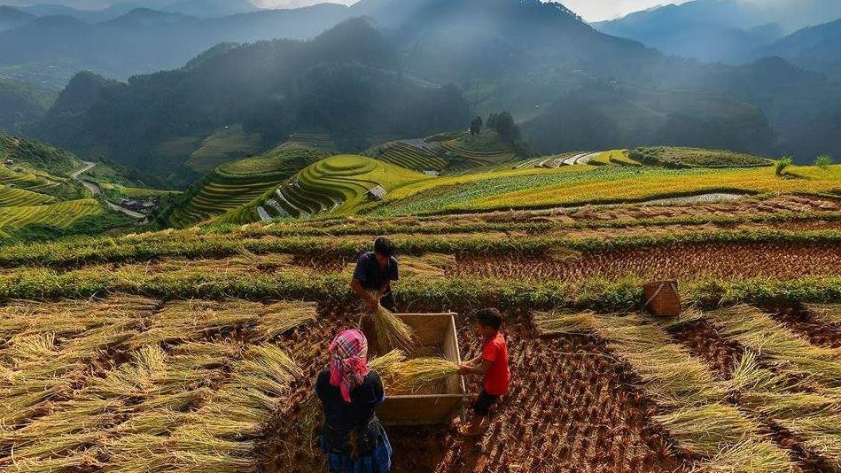
Analysing The Landscape Problems Solutions
Implementation and Impact Appendix

Slide 8




INTRODUCING PHOENIX
Implementation and Impact Assessment through breakdown of Strategy Phoenix
 |  |  |  |  |  | Immediate solutions
Potential solutions or micro-battles | Parameters of Assessment |  |  |  |  |  | Overall Attractiveness
 | Investment Required (CapEx: Small/Medium/Large) | Degree of Impact | Complexity of Implementation | Duration of Implementation (Rankings 1-5: longest - fastest) | Impact Segment from Identified Choke Points
Automation and Elimination of Legacy System | Medium | ~30% Lesser time taken for the loan acceptance process | Medium | ₃rd | Value Chain Inefficiency
Lending Circles | Small | ~800k+ People impacted by imparting Financial Inclusion | Low | ₄th | Improved Javan-Sumatran branch collaboration and facilitating rural banking
Revamping Credit Scores | Small | ~98.75% Accuracy in Repayment Prediction | Low | ₅th | Falling rates of loan recovery
Product Diversification | Medium | Increase in Cash Flow by 214 mn IDR | Medium | ₂nd | Expansion into Papua and other neighbouring regions
Credilink: Changing the landscape of Indonesian economy | Large | 8% Rise in Applied Loans | High | 1st (longest time) | Driving Fintech and changing landscape
Sources: Team Analysis
High | Moderate | Low
High | Medium | Low
Overview
Phoenix: Short Term
Phoenix: Long Term
Impact and Implementation
Appendix
4.

Slide 9








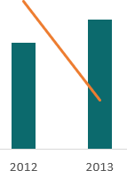
FACILITATING FINANCIAL INCLUSION AND EXPANSION OF UFH
Phased implementation of Lending Circles leading to financial inclusion of 800k+ people in the regions
Sumatra
Java
LENDING CIRCLES
>> Bridging the gap by Banking the Unbanked in Java and Sumatra through the launch of Lending Circles <<
Financial Inclusion
Community Lending
Impact Generated
Refer to Appendix
IDENTIFY
BUILD
IMPLEMENT
800k +
People directly impacted through Lending Circles
Targeting the Underutilized Agriculture Sector
80% farmers in Java don’t own the land
Employs 50.69% of the rural population in
Sumatra, especially in palm oil production
The Rising Need for Agricultural Loans
Applying for the Loan
Adopting Dual Model
Application Form and Survey
Financial Education Courses
Digital communication in tier 1
cities and towns
Leveraging existing agent network in Papua and NTT with poverty and illiteracy >20%
Joining the Group
Deciding Loan Amount and Order
Signing Loan Documents
Saving and Building Credit
Launch and Expansion
2.36%
Projected YoY Rise in Financial Inclusion
Decline in Agricultural loans as % of total loans while increase in IDR of the loans, signifying the gap in agricultural credit
Pilot project in Java and Sumatra to facilitate coordination
Expansion to Papua and East Nusa Tengarra in Phase 2
Loan offered at 0% interest rate
Payments reported to UFH
Credit Score updated
Sources: Mission Asset Fund. IMF, Team Analysis
Overview
Phoenix: Short Term
Phoenix: Long Term
Impact and Implementation
Appendix
5.

Slide 10
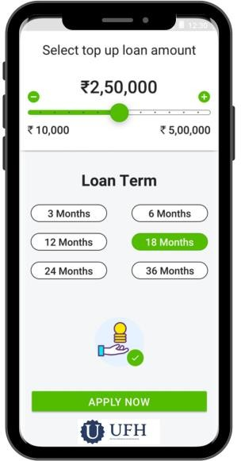






UFH’s CREDIT SCORING
Unveiling The Potential Of Automated Processing And An All-encompassing Credit Score
AI-volution: Optimising the Loan Procedure
Impact
IDR
Upto
3 days
Time Saved
Automation
Process
Digital Loan Application
Online form and documentation
Automated Document Verification through OCR
Loan Eligibility Assessment
Auxiliary Services (Training, Feedback)
IDR 512
mn
Aggregate Cost Savings
Estimated
Savings in Time
5.5 hrs 4.5 hrs 3.2 hrs 4.9 hrs 2.7 hrs
Loan Eligibility Assessment: Deep Dive
Current Methodology Our Solution: UFH Credit Score
Psychometric Retrospective
Factor | Weightage
Psychometric | 0.3
Retrospective | 0.4
Peer Scoring (through Vision Credit Re-imagined) | 0.3 Refer to App
Factor | Weightage
Payment History | 35%
Credit Mix | 10%
Amounts Owed | 30%
Length of Credit History | 15%
New Credit | 10%
50%
Honesty
50%
Reliability
Measured via 23 statements on Likert Scale
endix
Weighted Average of
Income
Credit Score to be calculated on the basis of weights with accelerated repayment and progressive lending plan for low scorers
Impact and Implementation Appendix
Sources: GBG Indonesia, McKinsey reports
Based Factors
Overview
Phoenix: Short Term
Phoenix: Long Term
6.

Slide 11






INTRODUCING CREDILINK : THE 3- PRONGED FINANCE (1/4)
Transforming the Micro Loan procedure through
Overview of Functioning of Credilink
Loan proposal
of IDR 3.5 mn
Data Feeding
Account Aggregator
Loan Product Provider
Loan Disbursement
Financial data like tax returns, financials as well as KYC compliances through proposed structure
Account-Aggregator(AA) process all applications including credit history verification, combining financial and alternate data-sets, monitoring loans and repayment tools
This is where UFH comes in. Being a part of a network like Credilink solves problems of financial inclusion, operational inefficiency and enables expansion
The finalized loan structures and terms are managed by a Ayocnnect, the finance Open API Platform for loan disbursement
Adika
28 year Old Farmer
IDENTIFICATION LAYER
DATA LAYER
PAYMENT LAYER
Loan Disbursal Assortments – Customer can choose amongst the varied loan amounts and interest rates
Loan Disbursement and Processing
Ayoconnect disburses loans on behalf of UFH with customer consent using data-layer architecture and intelligent
solutions like BI-Fast
COST OUTLAY: IDR 806.25 mn
Sources: Finatier's website
Refer to Appendix
Overview
Phoenix: Short Term
Phoenix: Long Term
Impact and Implementation
Appendix
7.

Slide 12














CREDILINK : THE IDENTIFICATION LAYER (2/4)
E-KYC: Addressing the Inefficiencies of the Current Credit Lending System by Addressing the Current Players
Structure of Current Credit Lending System
Mapping the Way Forward: Utilising e-KYCs
SOURCE COST PROCESS TIME
98%
of the adult population with Kartu Tanda Penduduk (e-KTP) ID card
Feasibility
of digital identity and e-KYC solution for financial inclusion highlighted by GoI
E-money players
1-2 Days(customer)
3-10 Days(Merchant)
1 day(customer)
1-3 Days(Merchants)
2 Months (G2P beneficiary)
IDR 16,000 –
115,000
P2P Lenders
Booming digital economy and fintech sector
IDR 26,000 –
76,000
Banks
IDR 24,000 –
64,000
USD 3.9-4.2 billion
Savings in Indonesian FinTech using e-KYC
Prolonged Loan Approval Duration Leading To Inefficiencies
Assessing the Industry's Value Chain
Real Time Biometric Authentication Customer Verification Activities and Automation
Refer to Appendix
5
Successful
High rates of errors and
false positives
Dependence on third parties
1
Online Customer onboarding
Unsuccessful
2
Web transferring of details by agent
Authentication
4
Authorised Party Intermediary
6
No single source to verify customer identity data
Risk of manipulation in data entered by the customer
Increase in
operational costs
3
8
Account
Generated
Financial Services Provider
(in-house application)
AML + Enhanced Due
7
Dilligence
Sources: MSC Policy
Overview
Phoenix: Short Term
Phoenix: Long Term
Impact and Implementation
Appendix
8.

Slide 13
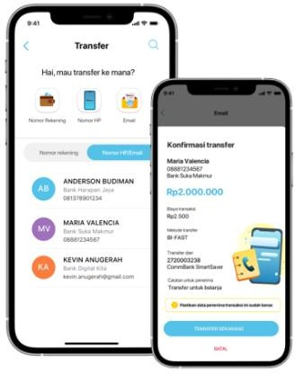



















CREDILINK : THE PAYMENT LAYER (3/4)
Moving Away From Legacy Systems And Leveraging The BI – Fast Service For Loan Disbursement
How it all started…
…to AyoConnect Disbursement Solution powered by BI-Fast
Loan Transfer Journey
2024
90% financial inclusion
Why partner with AyoConnect ?
Licensed by Bank Indonesia
Adika approaches UFH for loan needs
2022
Phased Expansion and Adoption of BI-
Fast
Flexibility to send funds to 70+ banks in
Indonesia that work together in real time
2021
Launch of BI-Fast
State Of The Art Dashboard to keep track of payment history and credit scores
UFH connects with loan disbursement facility
2020
Smartphone Penetration surpasses 75%
Lower transfer cost than market rate, priced at IDR 2400 ($0.16)
Choice of Payment Service for Loan Disbursement
Processing of loan via
BI Fast
Payment Service
Real- Time Transfer
Enhanced Security
Low
Charges
High Transfer
Limit
2019
Rollout of Financial Blueprint 2025
Online Transfer
RTGS
2017
Launch of QRIS and National Payment Gateway
BI- Fast
SKNBI
Loan Transferred and Adika’s financial needs are met
RTOL
Sources: GBG Indonesia, McKinsey reports
Overview
Phoenix: Short Term
Phoenix: Long Term
Impact and Implementation
Appendix
9.

Slide 14



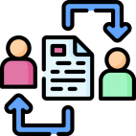







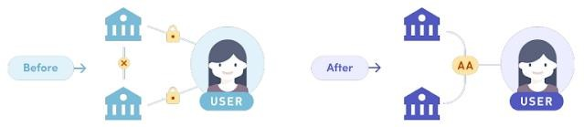
CREDILINK: THE DATA LAYER(4/4)
Leveraging Bank Indonesia's BI- FAST Service To Facilitate Real Time Transfer Of Micro Loans
Virtuous Cycle for an MSME Entrepreneur
I. Consent Artefact II. Financial Information Standards
A technology standard to replace all-permissive terms and conditions forms | O – Open for all R – Revocable(By Individuals) G – Granular (Sets the data access time) A – Auditable N – Notice (Provides information to all parties) S – Secure (By design) | Account-Aggregators (AA) like Finfini and Finantier could process loan applications instead of multiple banks
STEP 1
STEP 2
STEP 3
STEP 4
DIGITAL FOOTPRINTS
CONSENTED DATA SHARING
REGULAR BUSINESS CREDIT
BUSINESS GROWTH
TAX RETURNS AND BANK STATEMENT
Helping entrepreneurs get
capital, cash flow, credit, credibility, and lower interest rates
Provides a more complete financial picture of the borrower and simplifies lending decisions
USP of AA Model
Auli is an empowered MSME entrepreneur
Auli can now securely share their financial data with
financial institutions in the AA model
Sources: Team Analysis
Overview
Phoenix: Short Term
Phoenix: Long Term
Impact and Implementation
Appendix
10.

Slide 15



A DEEPER LOOK INTO THE PRODUCT OFFERINGS
Agriculture Financing enables tapping Unexplored Market Potential and facilitates Expansion
Current Offerings
New Offering: Reasons to expand into Agriculture
Individual Loans Problems solved through Credit Reimagined with
improved Financial Inclusion
Exploring the Demand-Supply Gap Political Factors
1051
Relative to GDP Contribution, Agriculture sector is underfunded
MiBank and Women’s Micro Bank are the only financial institutions to have introduced credit products aimed at rural agricultural communities
1
Failed Policy Initiatives: Kredit Usaya Rukyat limited to just 26% or IDR 36.4 trillion of all agricultural commodities
14.4
14.2
14
13.8
13.6
13.4
13.2
13
12.8
12.6
35
SMEs
Aided through Agricultural Value Chain Loans and Credilink
30
671
25
Share(GDP)
20
Percentage
15
10
2
5
Russia- Ukraine War: Effect on prices of fertilisers, a necessary raw material for the agriculture sector
54
Established Loyal Clients
Tapped through Credilink
0
2011 2012 2013 2014 2015 2016 2017
Share in GDP YoY Growth in Loans NPL Ratios
Graph showing the Demand-Supply Gap through underfunding via MFIs in Agriculture
Loan Application and Assessment Collateral Identification
Our Product Offering
Introduction
Loan Disbursement
Repayment
Agricultural Value Chain Loans
Loan Amount: IDR
7500(000)
Interest Rate: 21.2% p.a.
UFH taps contracts executed by the farmer in the value chain; sets terms to render loans at subsidized rates
This can be done through 3-pronged Credilink strategy
Order execution or completion of contract guarantees repayment of loan
Introduction meeting with farmers and identification of his need for loan
This application will include details about the borrower’s business plan, intended use of the funds. Analysis of the borrower's creditworthiness using UFH’s devised score
Sources: OJK, OECD Database
Overview
Phoenix: Short Term
Phoenix: Long Term
Impact and Implementation
Appendix
11.

Slide 16

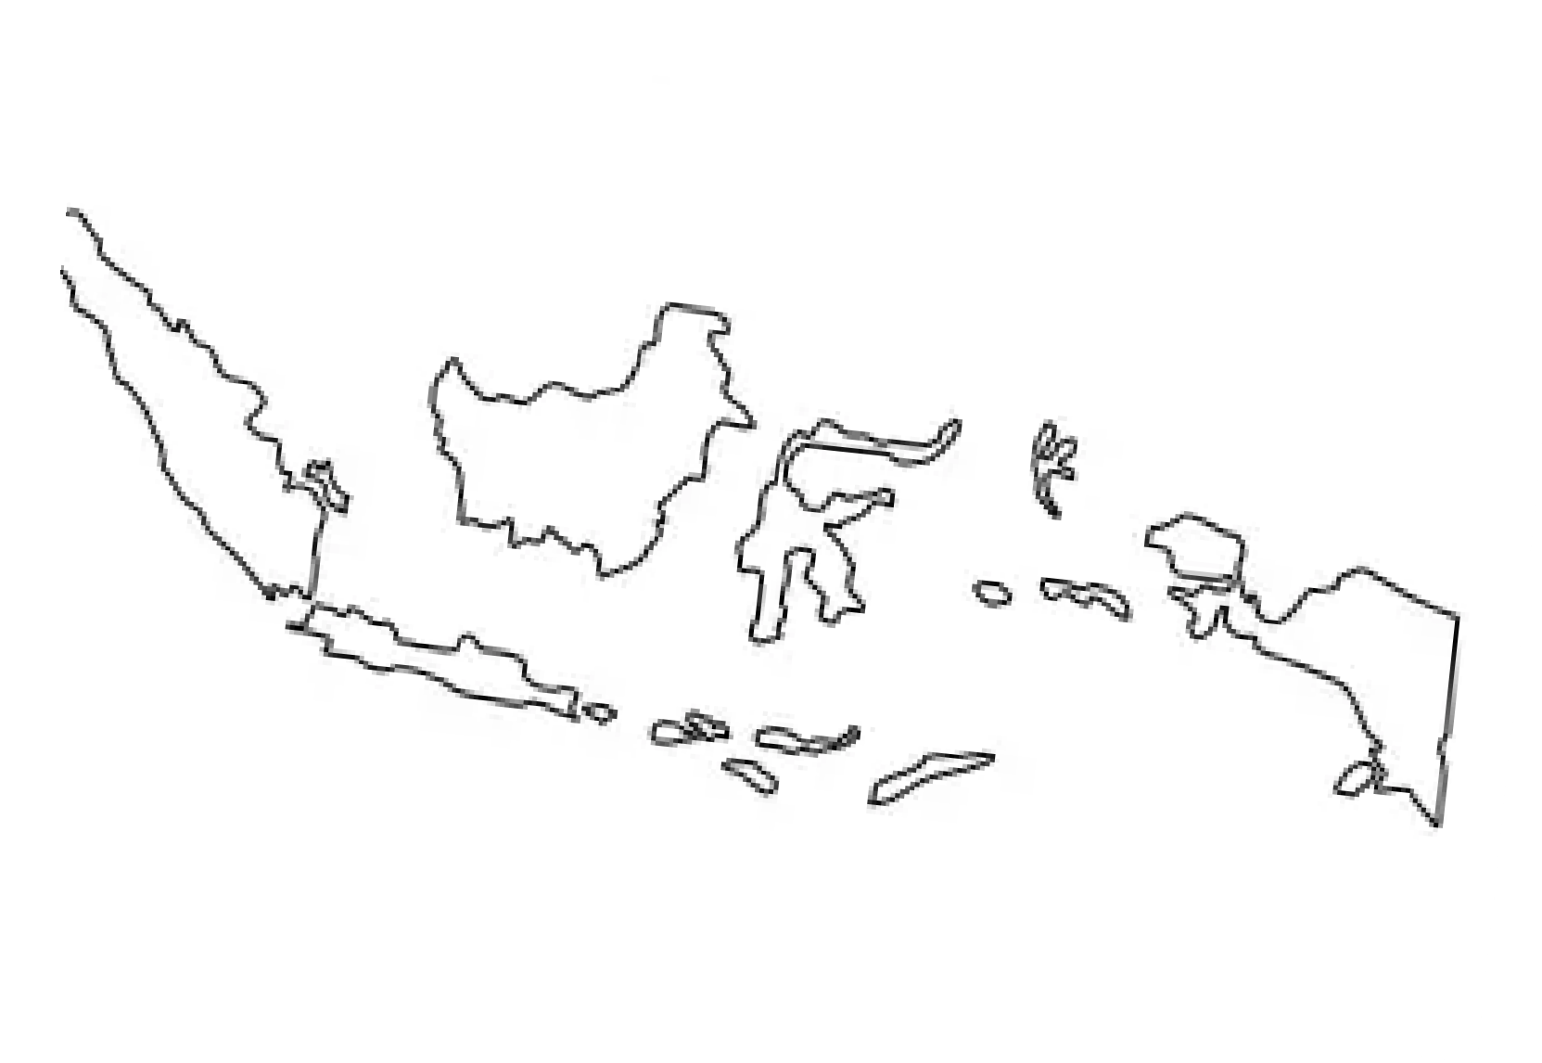

SCALING AND EXPANSION
Papua's Untapped Potential: Agricultural Diversification for Sustainable Household and Business Growth
Analysing the lending landscape in Papua and East Nusa Tengarra
Long Term Goals
Establishing Meaningful
Collaborations
People with Credit Product
Financial Inclusion
Share of Agriculture in GDP
3%
37%
17%
Low and Middle Income groups escape the Debt Trap through UFH’s Expansion
Phased Expansion Plan
Phase 1: Java and Sumatra
Phase 2: Papua and East
Nusa Tengarra
Phase 3: Nation Wide
Expansion
Perfecting the Model: Testing the feasibility, scalability and impact on operational efficiency through short term solutions of Strategy Phoenix
Huge Untapped Market: Over 900 farmer groups, less than 33% utilization capacity and no Agricultural Extension Training centres
Making use of lessons learnt from Phase 2 and Credilink to drive a nationwide macroeconomic
Time Frame: 3 yrs
Time Frame: 3 yrs
Time Frame: 2 yrs
Phase 1
Penetration Clientele: 5900+
Penetration Clientele: 6100+
Penetration Clientele:
Pan Indonesia
Phase 2
Refer to Appendix
Sources: OECD Database, Team Analysis
Overview
Phoenix: Short Term
Phoenix: Long Term
Impact and Implementation
Appendix
12.

Slide 17
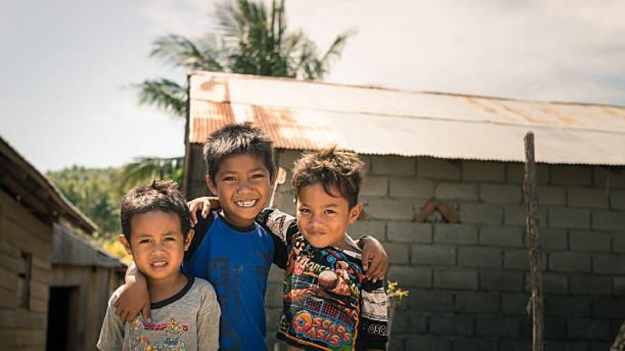
Analysing The Landscape Problems Solutions
Implementation and Impact
Appendix

Slide 18
RISK ANALYSIS AND MITIGATION
Suitable Strategies to help UFH preemptively tackle risks due to external and operational factors
Risk Mapping
Risk
Mitigation
KPIs
Note: Effect of Mitigating Actions shown by arrows
Invest in cloud computing, big data analytics
Conduct regular training for employees on efficient usage of new technologies
Update Operational Systems to leverage Technological Advancements
Reduction in Operational Costs
1
1
Modify or Add to Existing Product offerings to enhance Financial Inclusion
Conduct market research to understand the needs of low-income Indonesians
Partner with other financial institutions to offer new products
Increase in the number of Low-Income Indonesians who are able to save and invest
2
IMPACT
4
2
Restart Collaboration between Sumatra and Java
Create a shared IT platform
Establish joint marketing initiatives
Create a dedicated team to facilitate collaboration
Increased number of Regional Transactions
3
3
4
Introduce Agriculture Financing
Offer loans and savings products that are tailored to the needs of farmers
Increase in Farmers’ Income
PROBABILITY
Sources: Team Analysis
Overview
Phoenix: Short Term
Phoenix: Long Term
Impact and Implementation
Appendix
13.

Slide 19
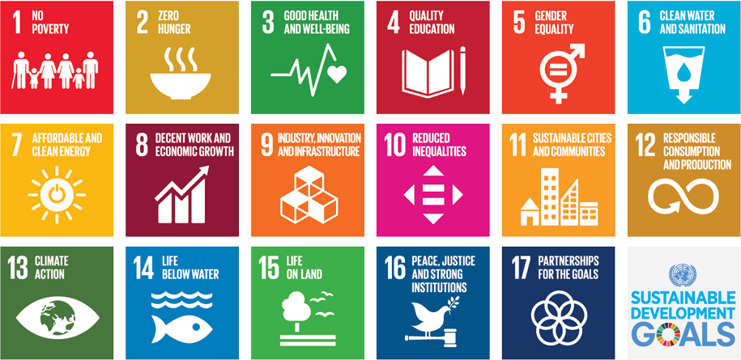


IMPLEMENTATION TIMELINE
Decoding the step by step formulation and implementation of Strategy Phoenix
Priority wise Collaborations to generate maximum impact…
...Impact creation through Fulfillment of SDGs
FINANTIER: Company solving
business problems via Tech
One step solution for Automation, Credit Scoring and
AYOCONNECT: Company aiding Loan Disbursement
Integral ending node of the Payment Layer in Credilink
Account Aggregation
1
Mechanism
2
Projected Timeline: Strategy Phoenix
Deploying the Self Devised UFH’s Credit Score
2023
2024
2025
2026
2027
Negotiations for Partnerships for Credit Reimagined
Automation, Elimination of Legacy Systems
Partnerships for Credilink
AVCL Launch
Credilink Implementation
Stage
Sources: Team Analysis
Phase 1
Phase 2
Phase 3(Pre Launch)
Overview
Phoenix: Short Term
Phoenix: Long Term
Impact and Implementation
Appendix
14.

Slide 20
FINANCIAL ANALYSIS OF THE PROPOSED STRATEGY
Leveraging the need of the hour to get a high positive NPV through Phoenix
Rise in Loan Acceptance Rate: Increase in Operational Efficiency and Financial
Inclusion
Number of Loans Accepted
Positive Cash Flows: Viable and Implementable Strategy
Cash Flow Projections(in mn IDR)
250
600.00
200
400.00
150
200.00
100
0.00
50
2024E
2025E
2026E
2027E
2028E
-200.00
0
2019A
2023A
Without Credilink With Credilink
2027F
-400.00
-600.00
Cost required to develop Credilink
Cost(in mn IDR)
-800.00
820
Why Strategy Phoenix?
800
36%
IRR
8969
(mn IDR)
Loans and Advances
8.21%
CAPM
1647
(mn IDR) NPV
780
760
740
720
2024E
2025E
2026E
2027E
2028E
Refer to Appendix
Sources: Team Analysis
Overview
Phoenix: Short Term
Phoenix: Long Term
Impact and Implementation
Appendix
15.

Slide 21
Analysing The Landscape Problems Solutions
Implementation and Impact
Appendix

Slide 22
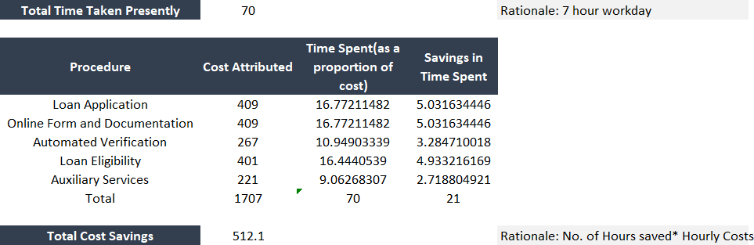
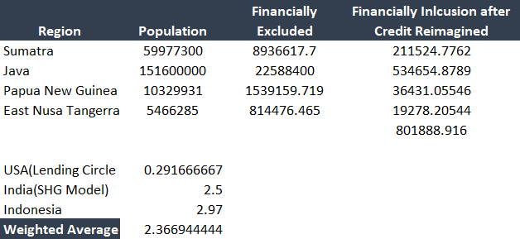
APPENDIX: AUTOMATION
Unveiling the potential of automated processing and an all encompassing credit score
Cost and time savings via automation
(Automation leads to a 30% fall in the time taken to complete each step, on an average)
Improvement in Financial Inclusion via Organic Growth of
our Credit Reimagined Policy

Slide 23
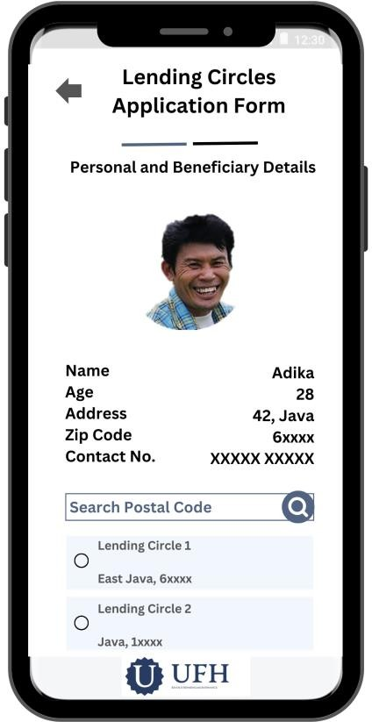
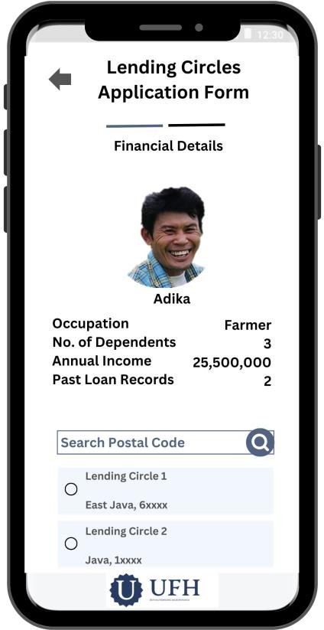



APPENDIX: LENDING CIRCLES
Exploring the mechanism
Lending Circles
Mobile Literate: Approximately 30% Targeted through Online Applications
Less Aware about Mobile Targeted through Agent Network
Agents or Field Officers visit the Tier 2/3 areas
Target groups individually after
looking at synchronized data server
Awareness through pamphlets, on the spot application filling using Officer’s device
Personal and Beneficiary Details Financial Details
Goal Fulfilled: Financial Inclusion

Slide 24
APPENDIX: CREDIT SCORING
Unveiling the potential of automated processing and an all encompassing credit score
Based on the final Credit Score, the following alternatives are recommended
The Lending Circle Risk Score(P2P Credit Score)
Any default increases lending circle risk score which if pushed beyond a limit will suspend loans.
Acts as measure of Social Capital
LOW SCORE
HIGH SCORE
The person is granted the loan
ACCELERATED REPAYMENT
amount and the repayment would not be in a accelerated manner, but normalized manner
Nominal Default | 1 risk score addition
Wrong Information Provided | 2 risk score addition
The loan repayment can be pushed a little earlier and at faster intervals, so that the overall risk is minimalised and spread out.
Establishment of 0% interest initial lending circles aims at financial inclusion of low and middle income households
Each circle would be required to furnish with details about the risk score of other members
Large number of responses collected will remove any bias involved
PROGRESSIVE LENDING
The loans can be lent out in a progressive manner with a higher rate starting from a smaller amount and then progressing towards larger sums to judge the credibility based on farmer’s repayment.
Adika, who struggled to get a loan earlier due to unavailability of information and low credit score is now granted a loan

Slide 25
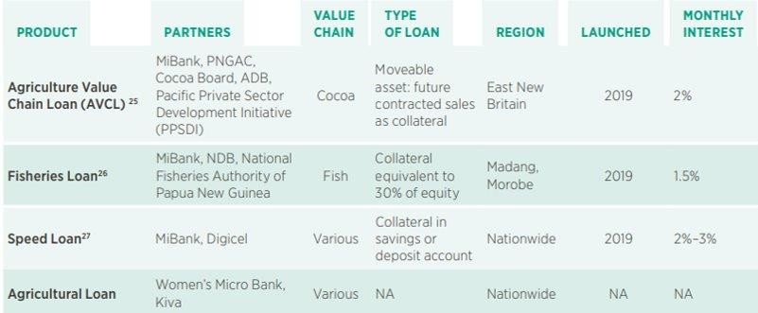
APPENDIX: PRODUCT OFFERINGS
Exploring the attractiveness of Agriculture Value Chain Loans
Current situation of farmers…
…Existing Loan Products available to small farmers in Indonesia(focus on Papua)
Only seven per cent of farmers interviewed had taken out a loan from a formal institution.
Unfamiliar with loan products
Both field agents and farmers prefer loan terms of six months or more to secure sufficient time for raising funds and repaying the loan.
Longer-Loan Terms
Fifty-five per cent said they needed the loan for multiple reasons (crop diversification, non-farm expenses) while 45 per cent said they would use the loan only for their
cash crop.
Diverse needs for credit
Our Solution: Revamping the product on the basis of Bottlenecks

Slide 26



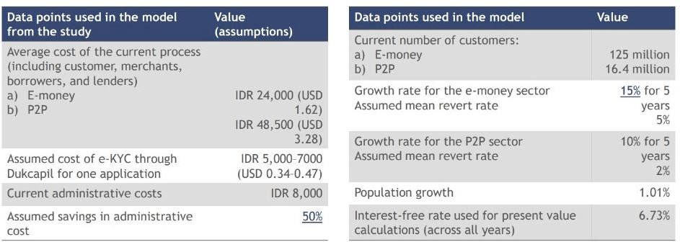
APPENDIX: CREDILINK
Choice of Account Aggregator and Key Savings through utilization of e-KYC
Choice of Account Aggregator
Account Aggregator | Ease of Use | Data cleanliness | API Offerings | Breadth of Connections
Finantier
FinFini
Musoni
Oradien
Choosing the Account Aggregator Finantier
Credilink Impact: Assumptions

Slide 27
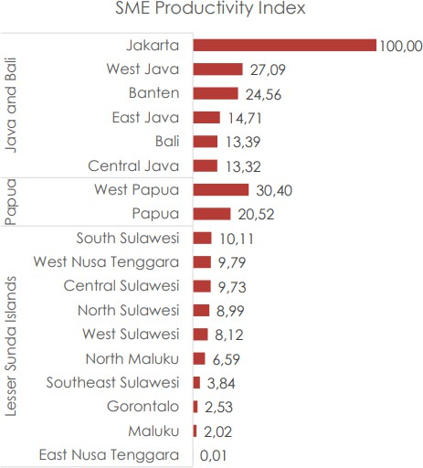
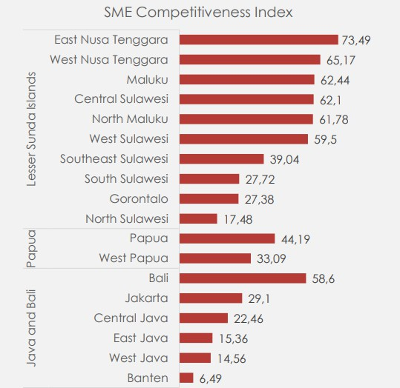
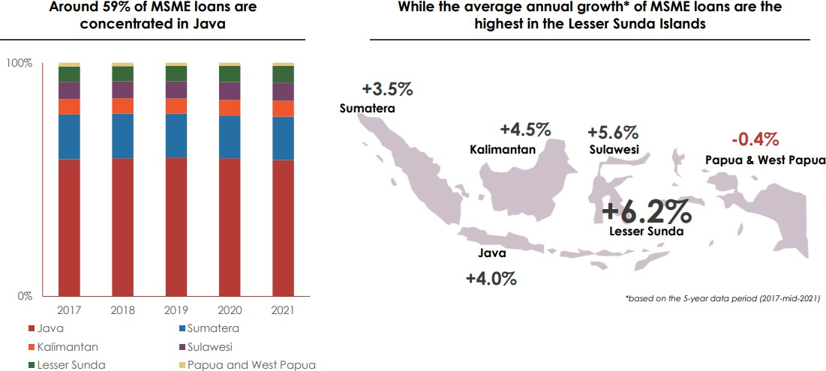
APPENDIX: Quantitatively Analysing Reasons for Expansion
Exploring the untapped SME loan potential of East Nusa Tengarra
Unmet Demand and High Growth Potential
Low disbursal of MSME loans
Highest Annual Growth Rate of loans
Lowest Productivity and Highest Competitiveness

Slide 28
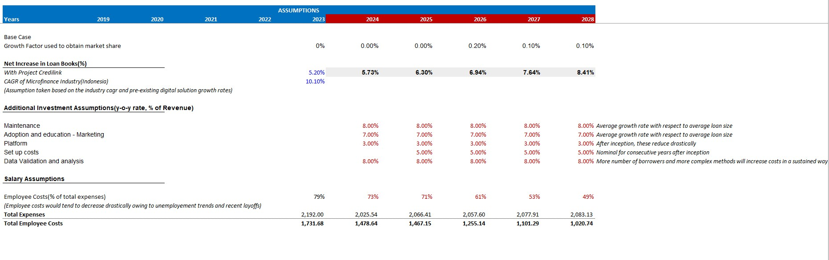
APPENDIX: ASSUMPTIONS
preliminary clarifications for assessing targeted market growth rate

Slide 29
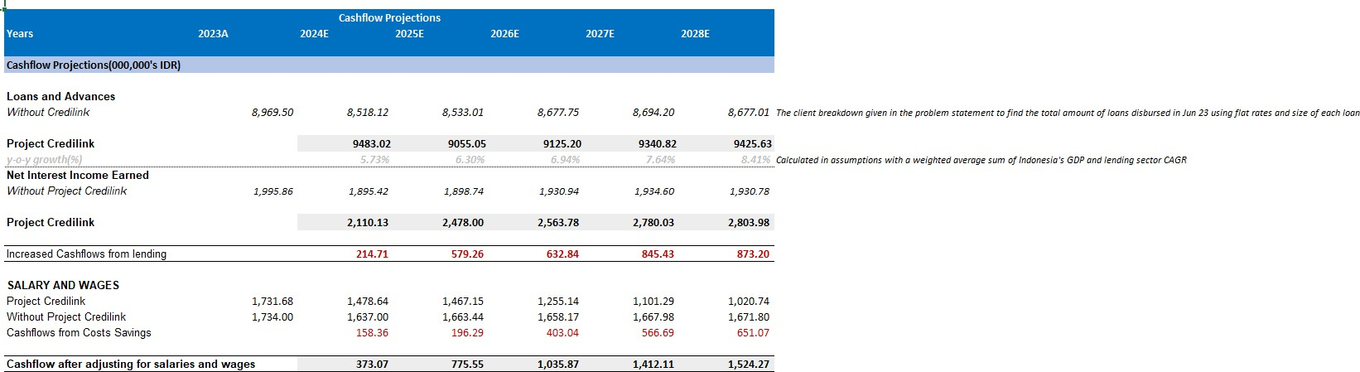
APPENDIX: CASH FLOW PROJECTIONS
Impact Assessment on the basis of Cash Flow Projections

Slide 30
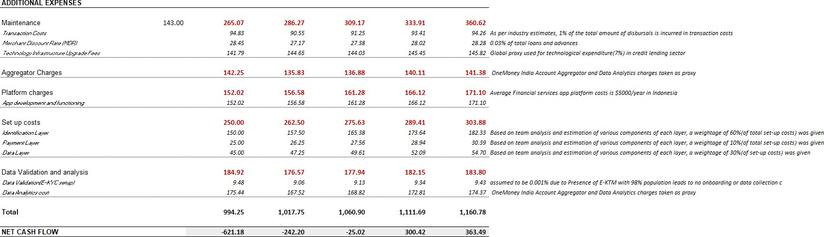
APPENDIX: CASH FLOW PROJECTIONS
Impact Assessment on the basis of Cash Flow Projections

Slide 31
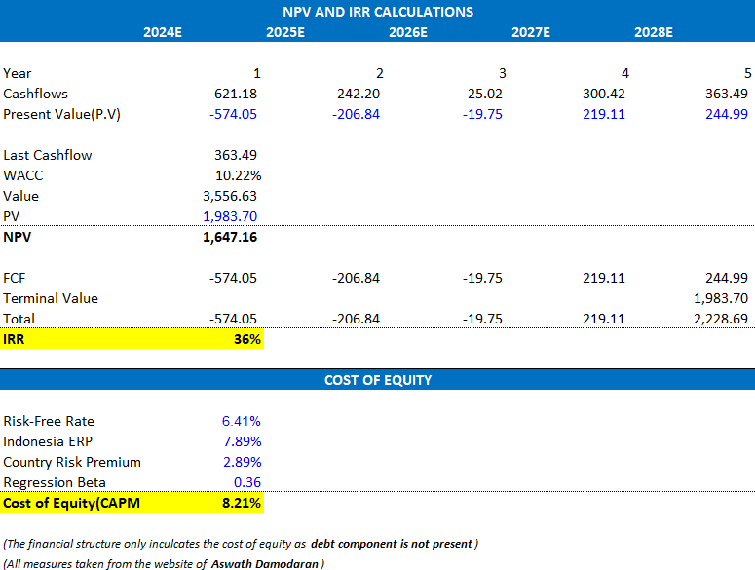
APPENDIX: KEY CALCULATIONS
Important financial indicators to justify out strategy

Slide 32
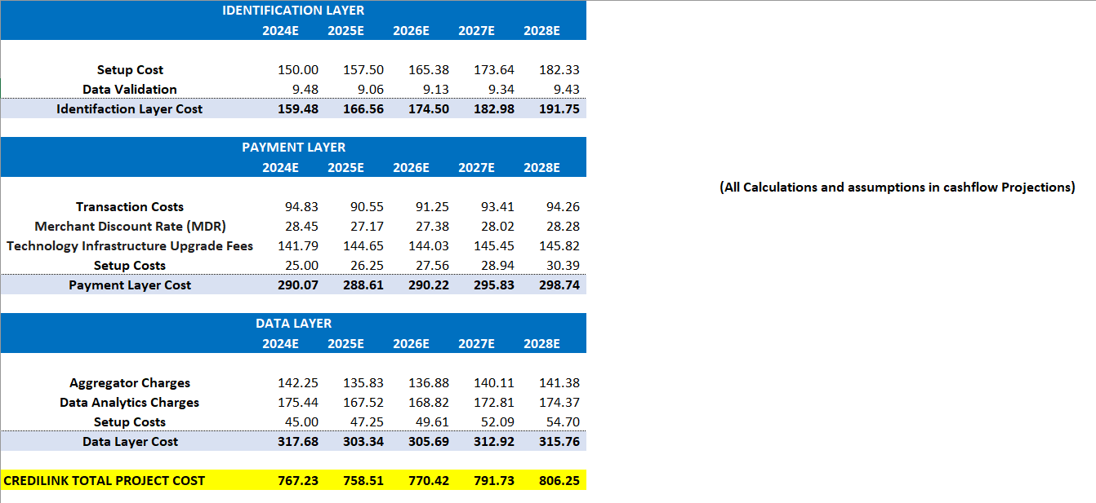
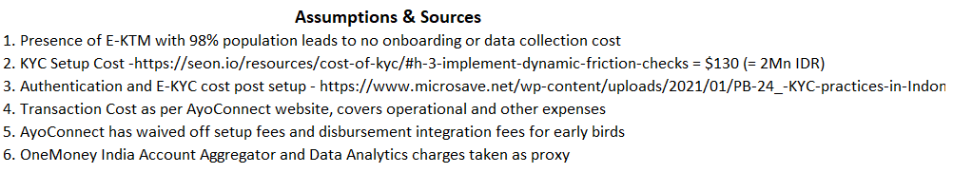
APPENDIX: CALCULATIONS FOR CREDILINK
Justifying Credilink’s 3-pronged costing strategy
810.00
806.25
800.00
791.73
790.00
780.00
767.23
770.42
770.00
760.00
750.00
740.00
730.00
758.51
2024E
2025E
2026E
2027E
2028E

Slide 33
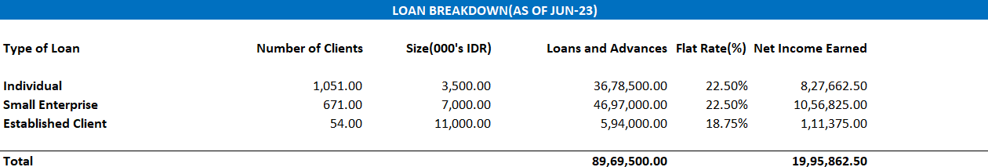
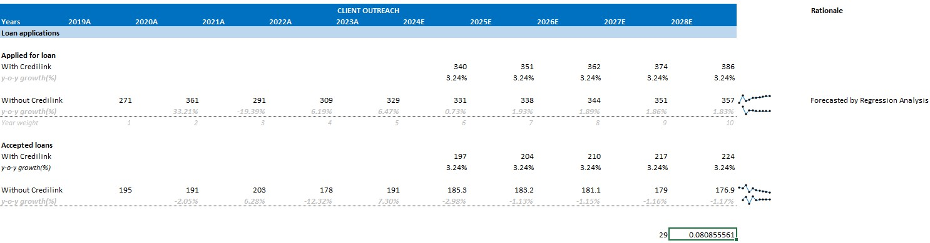
APPENDIX: LOAN BREAKDOWN AND CLIENT OUTREACH
Assessing the effect of Credilink on credit lending in Indonesia
Loan Breakdown
Client Outreach Projections

Slide 34
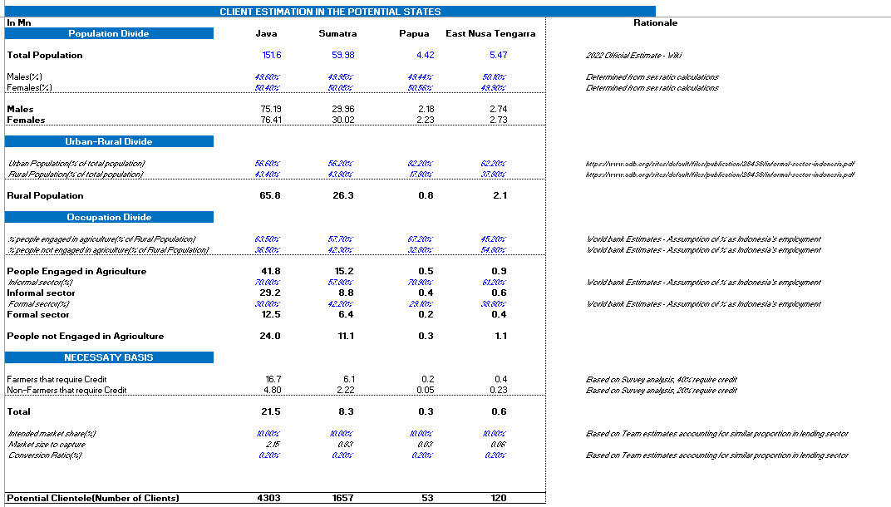
APPENDIX: MARKET PENETRATION
Estimating Market Size with Phoenix

Slide 35
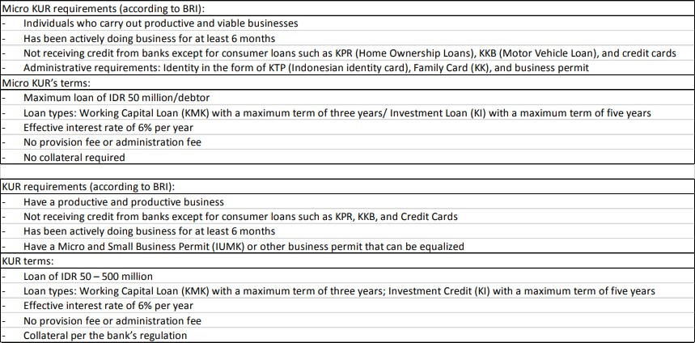
APPENDIX: FAILED INITIATIVE - KUR
Analysing Micro KUR requirements

Slide 36
APPENDIX: REFERENCES
The sources we referred to
https://www.ey.com/en_id/banking-capital-markets/riding-the-wave-of-indonesias-financial-services-growth
https://www.povertyactionlab.org/blog/2-12-21/strengthening-indonesias-branchless-banking-agent-network-
challenges-and-lessons
https://docs.finantier.co/id/v1#section/Identity-Verification
https://www.adb.org/results/microfinance-indonesia-bringing-banks-community
https://www.ojk.go.id/id/berita-dan-kegiatan/publikasi/Documents/Pages/Materi-OJK-PROKSI-
2016/3.Microfinance%2011032016%20-%20Bp.%20Mulya%20E.%20Siregar.pdf
https://www.jstor.org/stable/24310602
https://developers.bri.co.id/en/news/role-briapi-helping-microfinance-institutions-indonesia-go-digital
https://www.povertyactionlab.org/blog/2-12-21/strengthening-indonesias-branchless-banking-agent-network-challenges-and-lessons
https://www.docsumo.com/blog/artificial-intelligence-lending
file:///C:/Users/lenovo/Downloads/Blueprint-Sistem-Pembayaran-Indonesia-2025%20(1).pdf
https://finbraine.com/enhancing-better-and-faster-credit-decisions-with-automation-and-ai/
https://www.paisabazaar.com/credit-score/microfinance-credit-bureau-in-india/
https://www.myfico.com/credit-education/whats-in-your-credit-
score#:~:text=What's%20in%20my%20FICO%C2%AE,and%20credit%20mix%20(10%25).
https://www.sciencedirect.com/science/article/pii/S2405918822000095#fig7
https://techcrunch.com/2022/09/04/skorlife-gives-control-of-credit-data-back-to-indonesian-consumers/
https://www.ncbi.nlm.nih.gov/pmc/articles/PMC8082208/

Slide 37

Thank you

